Slide 1
Phishing Websites
Hagar 206002, Yossuf 197032, *Yasmine 206197

Slide 2
Dataset Description
Phishing arises when online trading occurring with unsecured money orders. The term phishing is used as a form of internet crime that is the creation of a well-known website that is essentially bogus to obtain confidential information. To detect phishing websites one must identify the length of the URL, IP address, domain’s prefix and suffix. So, this dataset is aimed to create a model that predicts the phishing websites and the legitimate websites, capturing the most important feaWe didn’t drop any duplicates as 50% of our data is duplicates and duplicates can be helpful in training and in generalizing our models.
We label encoded the dataset to normalize the data and to convert all the data from objects to integers.
We do not standardize (scale) the dataset as our dataset values ranges from -1 to 1.
The dataset is nearly balanced by the ratio of 45:55.

Slide 3
Data Preparation/Clustering
For outlier detections, we compared 3 methods to get the least number of outliers to drop as we need to retain as much data to not lose important features.
Elliptic Envelope (Gaussian-based Outlier Detection) results to 1k-4k outliers being detected.
Local Outlier Factor (KNN-Clustering) results to 500-2k outliers being detected.
Isolation Forest results to 4k outliers being detected.
We ended up using the Local Outlier Factor (KNN-clustering) to detect the outliers.

Slide 4
2. Data Preparation/Clustering
For choose the best method to balance the data to be used in each model, we compared 3 methods.
Oversampling: Duplicates dataset’s minority class instances.
Undersampling: Removes dataset’s majority class instances.
SMOTE: Generates new samples from the minority class instances.
SMOTE is the best method to balance the dataset in accuracy and precision, as it generates new samples from the minority class rather than duplicating the minority class instances (oversampling) or lowering the majority class samples (undersampling).

Slide 5
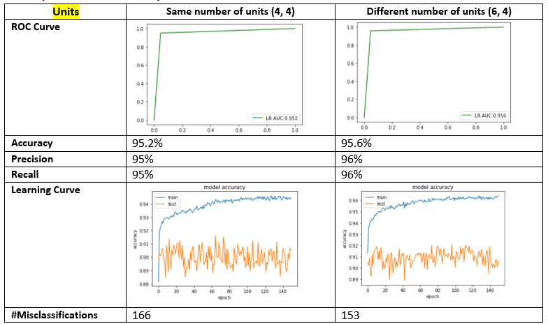
Simple MLP Model- 2 hidden layers
MLP Models- Dense and Sequential Classes used in Keras

Slide 6
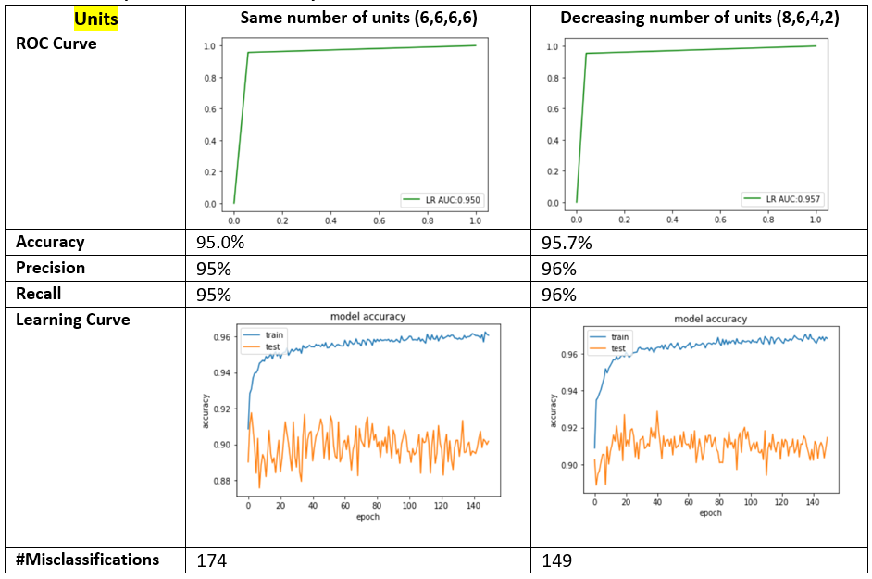
2. Complex MLP Model-4 hidden layers
MLP Models- Dense and Sequential Classes used in Keras

Slide 7
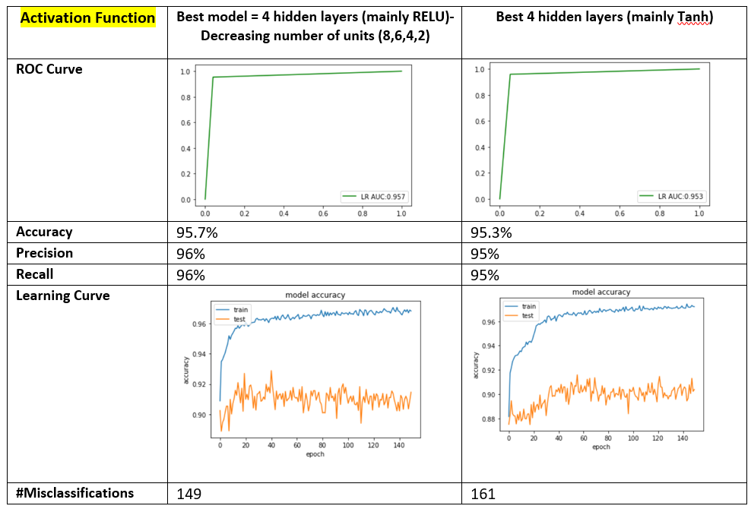
2. Complex MLP Model-4 hidden layers
MLP Models- Dense and Sequential Classes used in Keras

Slide 8
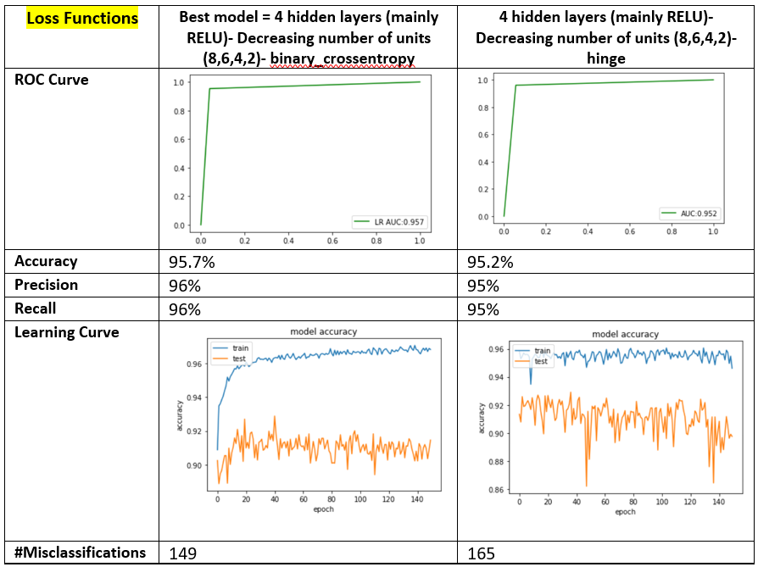
2. Complex MLP Model-4 hidden layers
MLP Models- Dense and Sequential Classes used in Keras

Slide 9
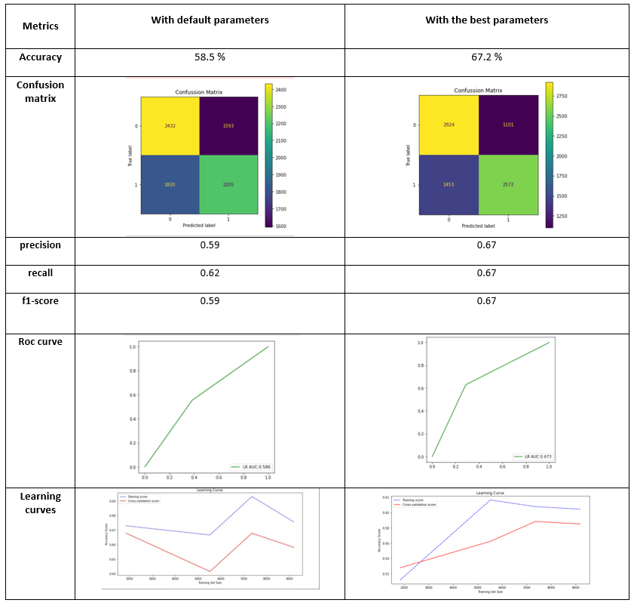
SOM Models

Slide 10
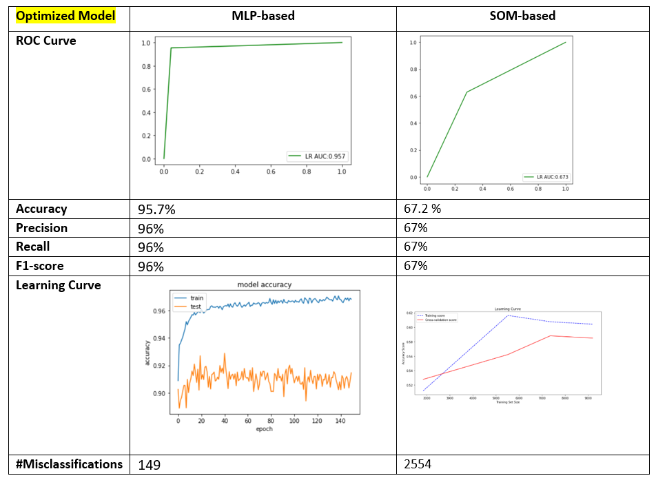
Optimized Models Comparisons

